Slide 1
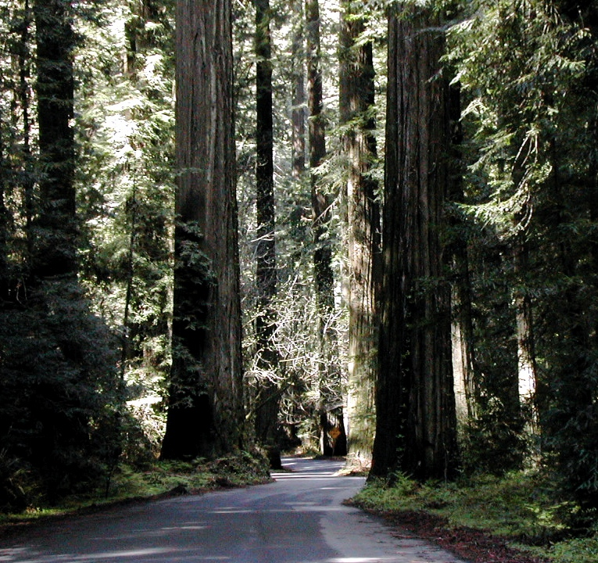

The Value of A Human Life
What Do Inappropriately Low Radiation Limits Mean?
Dr. James Conca Low Dose Radiation Conference
UFA Ventures/Herbert M. Parker Foundation Richland, WA
Richland, WA October 2018
www.forbes.com/sites/jamesconca/

Slide 2
The Problem As It Stands
Radiation risks to humans and the environment are assumed to exist as a result of any exposure, no matter how small (LNT)
Exposure to natural background is, on average, about 3 mSv/yr (300 mrem/yr), although global regional averages range from 0.03 mSv/yr to over 100 mSv/yr
It is not possible to see statistical evidence of public health risks at exposures less than 100 mSv/yr because any risk is well below the noise level of all other risks faced by humans or the environment
Regulations require nuclear waste disposal systems to meet release criteria, especially 0.04 mSv/yr to downgradient drinking water supplies, with no regard to cost or unintended effects

Slide 3
LNT
Small chronic doses of radiation, < 10 rem(cSv)/yr, appear to be easily handled by cellular repair mechanisms that evolved as a normal adaptive response with the emergence of the eukaryotic cell 2.3 billion years ago.
Risk
{
death
{
cancer
ARS
{
Few, if any, long-term health effects observed
threshold
Earth
background
0
0
0.1
1.0
10
100
1000
Dose (rem;cSv)

Slide 4
What are the costs of regulating radiation doses to such low levels?
How Much Do We Consider the Value of a Human Life to be?
$7 million is the value of a human life according to EPA
$316,000 is the average paid out in health care over a life
$129,000 is the average historic legal value of a human life
$12,420 (death benefit to families of deceased soldiers)
$45 million (value of a single healthy human life when chopped up and sold on the black market for body parts)
$2.5 billion per theoretical human life saved (LNT vs 0.1 Sv/yr)
$100 per human life saved by immunization against measles, diphtheria, and pertussis in developing countries

Slide 5
What Are Some Of The Costs Associated With
Exceptionally-Low Radiation Limits?
Our regulatory limits are so far down in the noise as to be meaningless from a public health standpoint
the noise of background radiation levels
the noise of everyday risks
LNT demands that there be an observable effect
as a function of dose
Notes:
Even when looking at non-lethal injuries, nuclear is the safest job you can have, safer than sitting at a desk trading stocks, safer than being a realtor.

Slide 6
Background Radiation Differences on Annual Cancer Mortality Rates/100,000 for each U.S. State over a 17-Year Period (adapted from Frigerio and Stowe, 1976 with correction for dose using more recent background data from radon).
Where is LNT? The hypothesis demands an expression whenever there is a spectrum of doses in a large population.
190
180
170
160
U.S. average
150
Mortality Rate/100,000
140
130
120
110
(270 mrem/y)
100
2.4
2.6
2.8
3.0
3.2
3.4
3.6
Background Dose (mSv/y)

Slide 7
812 excess cancers for 16,716 people, > 100 mGy
25,239 people
35,978people
27,511people
Source: Hargraves

Slide 8
Radiation risks are best considered relative to more common risks

Slide 9
Some behavioral risks facing Americans over the past 5 yrs
alcohol consumption
automobile driving
coal industry
construction
food poisoning
iatrogenic
murder
mining
nuclear industry
opioid deaths
police work
smoking tobacco
accidental falls (> 65 yrs old)
Notes:
How would you rank these activities in terms of most dangerous to least dangerous?

Slide 10
Number of Deaths in U.S.
Activity over the past 5 years
iatrogenic 950,000
smoking 760,000
alcohol 500,000
automobile accidents 180,000
opioid deaths 170,000
accidental falls (> 65 yrs old) 140,000
coal use (32% of U.S. power) 60,000
murder 80,000
food poisoning 25,000
construction 5,000
police work 800
mining 360
nuclear industry (19% of U.S. power) 1
(medicine gone wrong)

Slide 11
Relative
Number of Deaths in U.S. Danger
Activity Normalized to Sub-Population Index
1) smoking (43.4 million smokers) 760,000 0.01751
2) alcohol (60 million impacted Americans) 500,000 0.00833
3) iatrogenic (180 million receive medical treatment) 950,000 0.00527
4) accidental falls (46 million over 65 yrs) 140,000 0.00304
5) police work (680,000 police officers) 800 0.00118
6) mining (350,000 miners) 360 0.00103
7) automobile accidents (190 million drivers) 180,000 0.00094
8) construction (7.7 million workers) 5,000 0.00065
9) opioid deaths (100 million prescribed) 170,000 0.00043
10) murder (300 million impacted) 80,000 0.00027
11) coal use (240 million impacted) 60,000 0.00025
12) food poisoning (304 million eat every day) 25,000 0.00008
13) nuclear industry (60 million) 1 0.0000001

Slide 12
What Are Some Of The Costs Associated With
Exceptionally-Low Radiation Limits?
Commercial Nuclear Industry – increases costs and increases fear of nuclear power in the public
Environmental Concerns – fear prevents nuclear power from addressing climate change, human health and the environment
Nuclear Waste – increases cost of repositories and prevents siting at most optimum geographic and geologic locations
Medicine - causes radiation phobia that prevents certain medical diagnostics and treatments involving radiation
Emergency Preparedness - causes extreme radiation phobia after nuclear/radiological accidents that have harmed or killed more people than the incident itself (Fukushima, Chernobyl, future dirty bomb attack) and that prevents reasonable emergency planning and execution in future disasters
Notes:
Even when looking at non-lethal injuries, nuclear is the safest job you can have, safer than sitting at a desk trading stocks, safer than being a realtor.

Slide 13
What Are Some Of The Costs Associated With
Exceptionally-Low Radiation Limits?
Causes extreme radiation phobia following nuclear or radiological incidents and accidents
Loss of lives and severe injuries associated with frantic evacuations
Increased suicides and psychosomatic disorders
- Increased drug/alcohol/cigarette abuse
Unnecessary permanent abandonment of properties for contamination well within the levels of natural Earth background
Extreme costs of clean-up relative to actual risk
Notes:
Even when looking at non-lethal injuries, nuclear is the safest job you can have, safer than sitting at a desk trading stocks, safer than being a realtor.

Slide 14
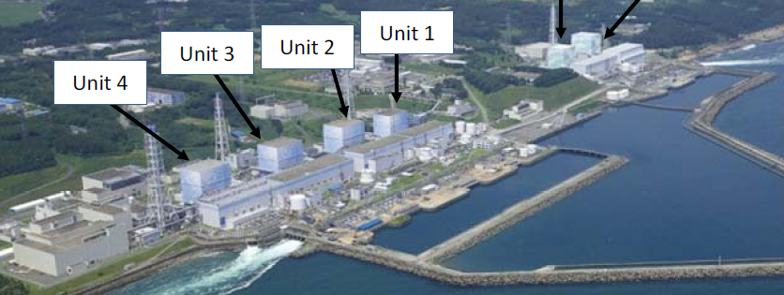
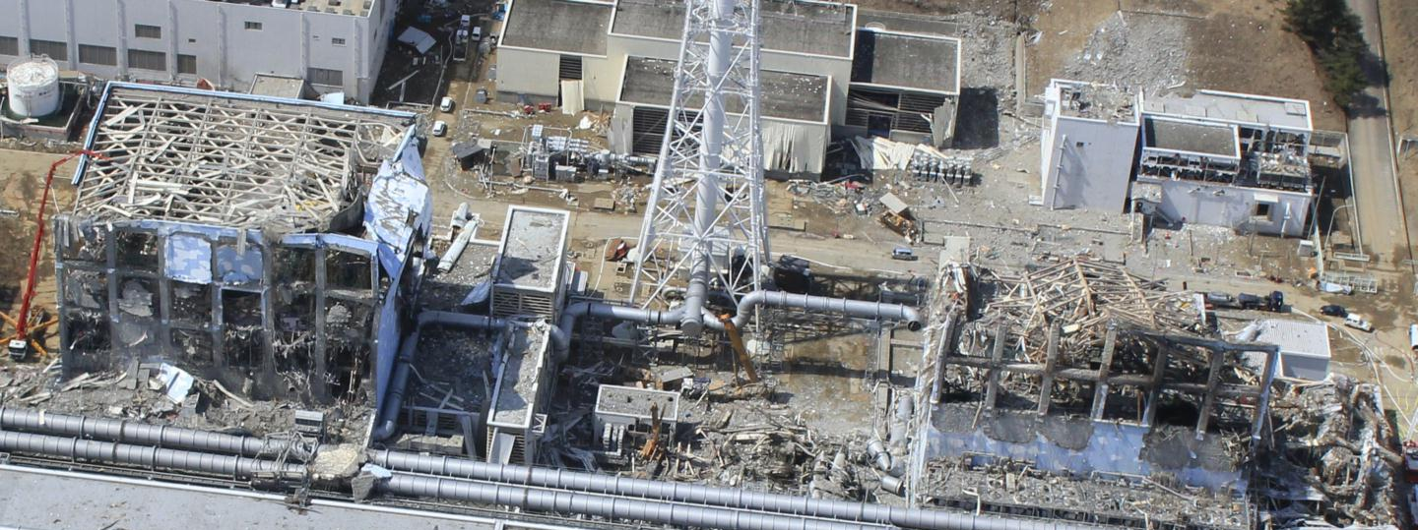

After the hydrogen explosions
Unit 3
Unit 4

Slide 15
What Are Some Of The Costs Associated With
Emergency Preparedness and Execution?
Evacuation of 160,000 from provinces surrounding Fukushima resulted in about 1,600 deaths mainly of elderly and disabled. Most adults could have returned after 2 months (I-131)
According to the World Health Organization -
no acute radiation injuries or deaths among workers or public from exposure to radiation resulting from Fukushima accident.
the lifetime radiation-induced cancer risks are much smaller than the lifetime baseline cancer risks.
For about 160 workers who received whole body effective doses over 100 mSv, expected increased cancer risks will not be detectable against the normal statistical fluctuations in cancer incidence for this population.
Notes:
Even when looking at non-lethal injuries, nuclear is the safest job you can have, safer than sitting at a desk trading stocks, safer than being a realtor.

Slide 16
What Are Some Of The Costs Associated With
Emergency Preparedness and Execution?
Over 50% of residents have finally returned, mostly older citizens, but the damage has been done – Government estimates the cost at over US$200 billion.
at an average of $39,000 per capita GDP, revenue losses since 2011 exceed $40 billion for that cohort
$12 billion in compensation paid to displaced residents
Unnecessary shutting of all nuclear plants, most were not at risk
increased fossil fuel use by about 25%
increased energy prices by about 20%
lowered air quality (estimates of > 15,000 additional premature deaths from fossil fuel particulate emissions)
Notes:
Even when looking at non-lethal injuries, nuclear is the safest job you can have, safer than sitting at a desk trading stocks, safer than being a realtor.

Slide 17
What Are Some Of The Costs Associated With
Emergency Preparedness and Execution?
Japan’s Government foolishly lowered the radiation limits on food after Fukushima thinking that would appear as proactive
Regulatory Limits On Radioactivity In Foods (in Bq/kg)
Country Water Milk Foodstuffs Babyfoods
Japan 10 200 100 50
U.S. 1,200 1,200 1,200 1,200
E.U. 1,000 1,000 1,250 400
Notes:
Even when looking at non-lethal injuries, nuclear is the safest job you can have, safer than sitting at a desk trading stocks, safer than being a realtor.

Slide 18
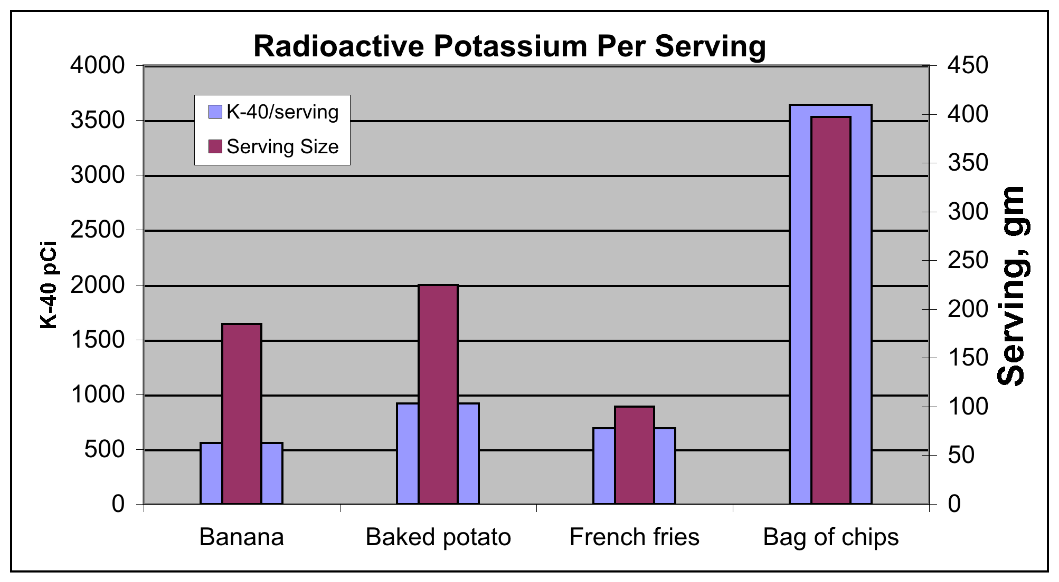
Source: Dan Yurman, 2011

Slide 19
What Are Some Of The Costs Associated With
Emergency Preparedness and Execution?
Japan’s Government foolishly lowered the radiation limits on food after Fukushima thinking that would appear as proactive
destroyed much of the farming and fishing industry in northern Japan, even in areas unaffected by any radiation: >$10 billion losses
But with its own Chernobyl effect, the Fukushima disaster proved to make the fisheries off the coast a de facto marine protected area and fish stocks have tripled in these waters since 2011
Regulatory Limits On Radioactivity In Foods (in Bq/kg)
Country Water Milk Foodstuffs Babyfoods
Japan 10 200 100 50
U.S. 1,200 1,200 1,200 1,200
E.U. 1,000 1,000 1,250 400
Notes:
Even when looking at non-lethal injuries, nuclear is the safest job you can have, safer than sitting at a desk trading stocks, safer than being a realtor.

Slide 20
What Are Some Of The Costs Associated With
LNT for Nuclear Waste Disposal?
Main effect has been to completely stop our nuclear waste disposal program because of fear, preventing science-based decisions:
gave us glass over grout for HLW, even thought grout is better, and cheaper, for most HLW
the Hanford vitrification program, not including repository costs, will exceed $90 billion versus $30 billion for grouting and disposal elsewhere (not including repository costs), versus $30 billion for grouting in-place, even though there is no statistical difference in their risks.
has made it impossible to site a repository and has prevented us from correctly reclassifying HLW at Hanford to RH-TRU
unnecessary engineered barriers at Yucca Mt, such as Ti-drip shields ($30 billion), increasing total disposal costs by over $200 billion
Notes:
Even when looking at non-lethal injuries, nuclear is the safest job you can have, safer than sitting at a desk trading stocks, safer than being a realtor.

Slide 21
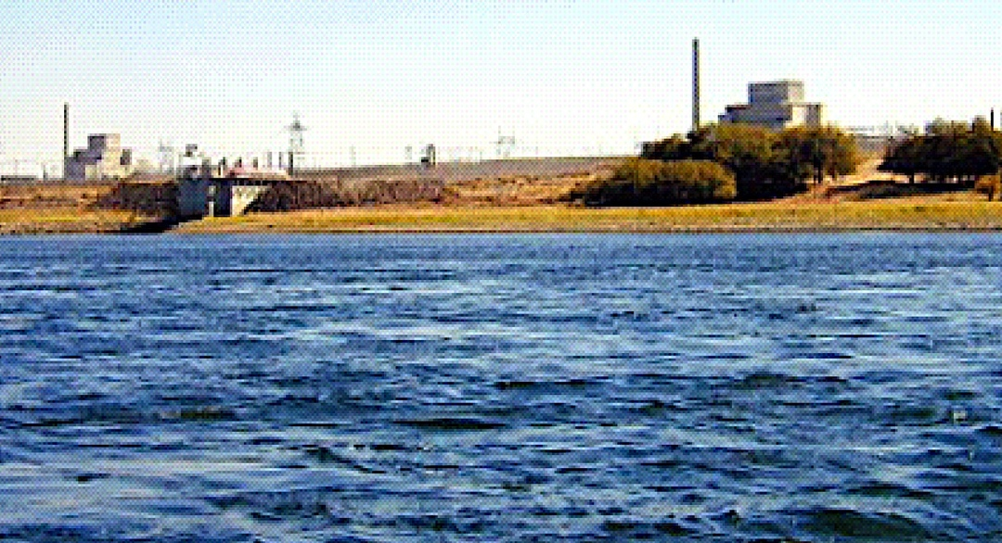
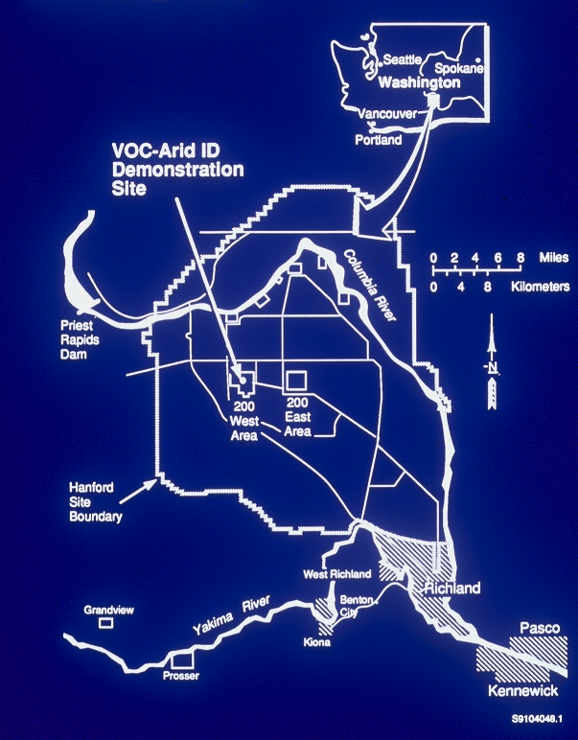
What Are Some Of The Costs Associated With
LNT for Nuclear Waste Disposal?
The Hanford Nuclear
Reservation
Tank Farms
Notes:
Even when looking at non-lethal injuries, nuclear is the safest job you can have, safer than sitting at a desk trading stocks, safer than being a realtor.

Slide 22

FUEL
ASSEMBLIES
What is HLW or nuclear bomb waste?
- 57 million gallons at Hanford
- 1.4 million is CH-TRU
What is HLW or nuclear bomb waste?
- 57 million gallons at Hanford
- all is now RH-TRU or CH-TRU
CLADDING REMOVAL
(Coating Dissolution)
COATING REMOVAL WASTE
SPENT FUEL
REPROCESSING
PLUTONIUM DECONTAMINATION
PLUTONIUM
CONCENTRATION
PLUTONIUM PRODUCT
URANIUM
DISSOLUTION
URANIUM
SEPARATION
1ST DECON
CYCLE
2ND DECON
CYCLE
IN 224 B & T
PROCESSING PLANTS
METAL WASTE
DECONTAMINATION CYCLE
WASTES
BUILDING 224 CONCENTRATION WASTES
Since 1970, most Cs/Sr has been removed, others mostly decayed, so now tanks are TRU
HLW
TRU
Other SSTs
SSTs B-201 through B-204,
T-201 through T-204,
and T-104, T-110, & T-111

Slide 23
TIMEFRAME
EPA 40 CFR 191
1,000-year requirement
4 mrem/year whole body (water)
25 mrem/year whole body (all pathways)
75 mrem/year critical organ
10,000-year requirement
Curie release limits
1-in-10 chance of exceeding the limit
1-in-1000 chance of exceeding 10x the limit

Slide 24
4 mrem/year whole body (water)

Slide 25
Tank Closure Alternatives For The DOE Environmental Impact Statement

Slide 26
But RH-TRU and HLW have different disposal pathways so the Tank EIS may not be correct
Table S-10. tank Closure Alternatives - Summary of Radiation Dose and Hazard Index at
Year of Peak Dose/Hazard Index for the Drinking-Water Well User
Note: Calendar year of peak impact shown in parentheses
Tank Closure Alternative | Core Zone Boundary |  | Columbia River Nearshore
 | Radiation Dose (millirem per year) | Hazard Index | Radiation Dose (millirem per year) | Hazard Index
1 | 58.88 (4313) | 9.20 (2500) | 4.37 (4978) | 1.01 (4498)
2A | 8.64 (2069) | 5.26 (2068) | 0.941 (2317) | 1.01 (2079)
4\2B, 3A, 3B, 3C, 6C | 7.58 (2056) | 4.81 (2050) | 0.885 (2242) | 0.971 (2076)
4 | 7.41 (2056) | 4.80 (2050) | 0.882 (2242) | 0.971 (2076)
5 | 7.57 (2056) | 4.81 (2050) | 0.894 (4809) | 0.971 (2076)
6A, Base Case | 7.37 (2056) | 4.80 (2050) | 0.876 (2251) | 0.971 (2076)
6A, Option Case | 7.64 (2066) | 5.22 (2051) | 0.899 (2251) | 0.912 (2076)
6B, Base Case | 7.35 (2056) | 4.80 (2050) | 0.822 (2218) | 0.972 (2076)
6B, Option Case | 7.92 (2065) | 5.23 (2083) | 0.807 (2218) | 0.830 (2074)

Slide 27
RH-TRU and HLW have different disposal pathways, an EIS for grouting is more applicable and was actually performed. Comparing with the recent tank EIS, w/1G as Grouting in Place:
Table S-10. tank Closure Alternatives - Summary of Radiation Dose and Hazard Index at
Year of Peak Dose/Hazard Index for the Drinking-Water Well User
Note: Calendar year of peak impact shown in parentheses
Tank Closure Alternative | Core Zone Boundary |  | Columbia River Nearshore
 | Radiation Dose (millirem per year) | Hazard Index | Radiation Dose (millirem per year) | Hazard Index
1 | 58.88 (4313) | 9.20 (2500) | 4.37 (4978) | 1.01 (4498)
1G | 8.10 (2400) | 5.10 (2300) | 0.910 (2700) | 0.990 (2080)
2A | 8.64 (2069) | 5.26 (2068) | 0.941 (2317) | 1.01 (2079)
4\2B, 3A, 3B, 3C, 6C | 7.58 (2056) | 4.81 (2050) | 0.885 (2242) | 0.971 (2076)
4 | 7.41 (2056) | 4.80 (2050) | 0.882 (2242) | 0.971 (2076)
5 | 7.57 (2056) | 4.81 (2050) | 0.894 (4809) | 0.971 (2076)
6A, Base Case | 7.37 (2056) | 4.80 (2050) | 0.876 (2251) | 0.971 (2076)
6A, Option Case | 7.64 (2066) | 5.22 (2051) | 0.899 (2251) | 0.912 (2076)
6B, Base Case | 7.35 (2056) | 4.80 (2050) | 0.822 (2218) | 0.972 (2076)
6B, Option Case | 7.92 (2065) | 5.23 (2083) | 0.807 (2218) | 0.830 (2074)

Slide 28
What Are Some Of The Costs Associated With
LNT for Nuclear Waste Disposal?
For the Hanford tanks, vitrification and shipment to Yucca Mt ($250 billion) costs an extra $200 billion to save 3.3 mrem/yr in the year 4978 relative to reclassification, stabilization and shipping to WIPP ($60 billion), or to grouting in place ($30 billion) that have the same benefits.
For all other decommissioning and clean-up activities at DOE sites, raising limits to 40 - 100 mrem(1 mSv)/yr would save another $100 billion or so.
Globally, the cost for compliance to LNT-based standards is upwards of US$1 trillion
Notes:
Even when looking at non-lethal injuries, nuclear is the safest job you can have, safer than sitting at a desk trading stocks, safer than being a realtor.

Slide 29
Revised DOE 2006 Estimate of Savings for Adjusting Cleanup Costs to more Reasonable Alternative Standards for U.S. DOE sites
400
350
300
250
Clean-up Costs ($billions)
200
150
100
$420 billion in savings
50
0
0
15
20
40
60
80
100
Radiation Level Standards (mrem/yr;1/100thmSv/yr)

Slide 30
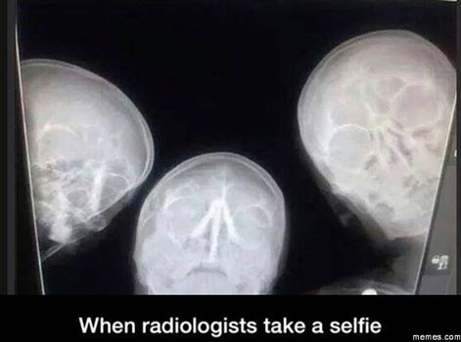
Thank You!
Questions?

